Slide 1

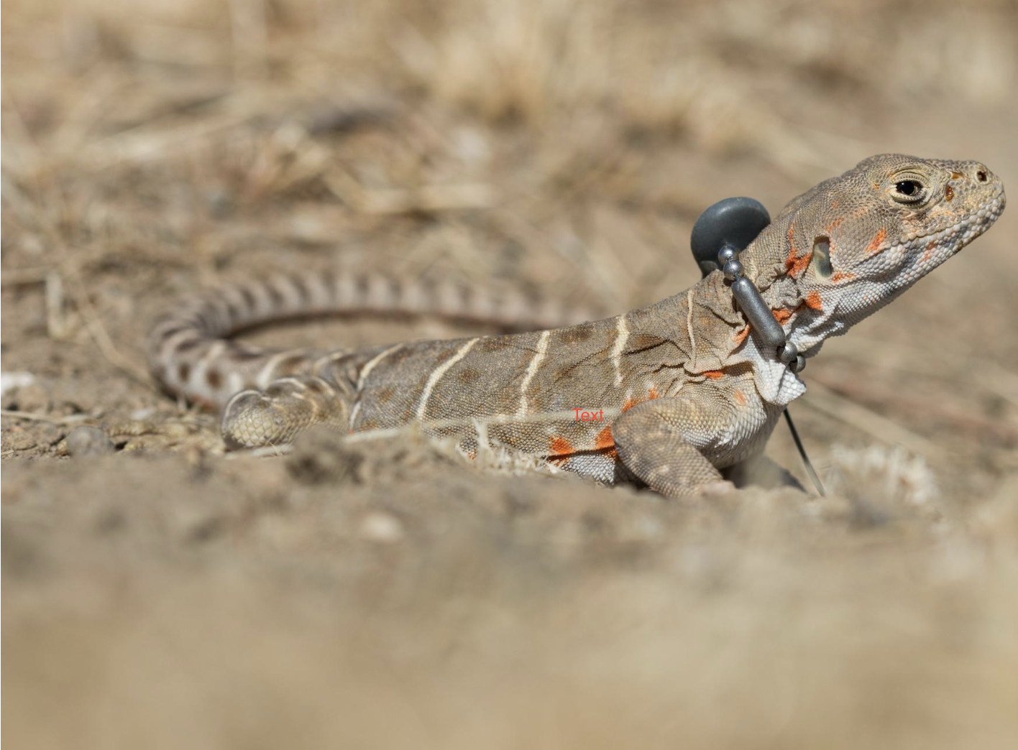
Lizard Localization
Vinit Saah, Joey Schnecker, Ryan Margraf, Hassan Ahmad

Slide 2
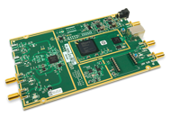
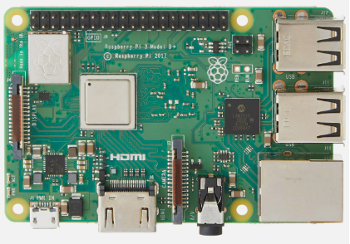
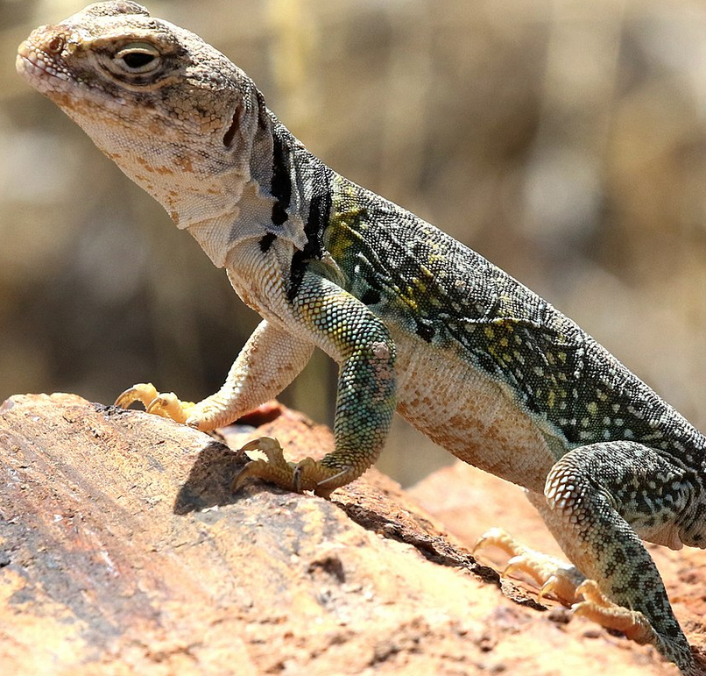

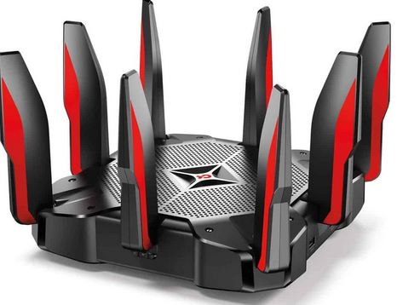
Project Overview
Goal is to localize a single transmitter using multiple receivers by TDOA calculations
Approach is to break down the problem into several subtasks that can be stitched together.
Subtasks include:
TB: Test bench setup and measurements
LOC: Localization simulations
DSP: Signal processing algorithm development
UI: User Interface Design
The MVP for the final demonstration is to have a system that uses at least 2 receivers to collect data, estimate the possible positions of a transmitter, and shows a visualization of the estimations.
2 receivers because we may not have enough hardware for to do more than that.
Base Station #1
Base Station #2
Receiver
Gateway
Receiver
Gateway
End Device
Central Compute
Base Station #3
Base Station #4
Receiver
Gateway
Receiver
Gateway

Slide 3
Basic Block Diagrams
AWG/GPSDO
Storage
2
4
Rx (USRP)
3
DSP
(Host 1)
5
6
Localization
Host
Controller
1
Tx
UI
1
3
5
Rx (USRP)
DSP
(Host 2)
2
4
Storage
AWG/GPSDO

Slide 4
Host controller – Host(DSP) interaction
Server /Client Model.
Host Controller: Server
Host (DSP): Client
In same network (WIFI)
TCP Sockets
Host Controller waits for Client to connect.
Upon connection, controller sends command to configure USRP and synchronize
Client upon configuration and synchronization performs DSP
Client then sends finish command to server
Server upon finish command retrieves stored files via SCP

Slide 5
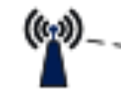
HOST- USRP Interaction
Host 1 configures USRP
Central Frequency
Subdev
Channel
Antenna
Bandwidth
Sample Rate
Configures Clock (External)
Configures Timing (External)
Synchronization :
AWG : at the same moment
GPSDO: 1 sec, Max 1 min
Receives sample with Metadata
Performs Cross correlation
Store cross correlated output in the file
Storage
AWG/GPSDO
Rx (USRP)
DSP
(Host 1)
Tx

Slide 6
Host controller- Localization
Receiver Coordinates
Localization Algorithm
Estimated Location
Times of Arrival (from DSP)
Range Differences

Slide 7
Progress: Hardware Acquisition
Two USRP-2920 Transceivers
AWG
Cables
Connectors
Cheap GPSDO
Still Needed:
PD-2 Transmitter
USRP B200 Transceivers
Expensive GPSDO

Slide 8
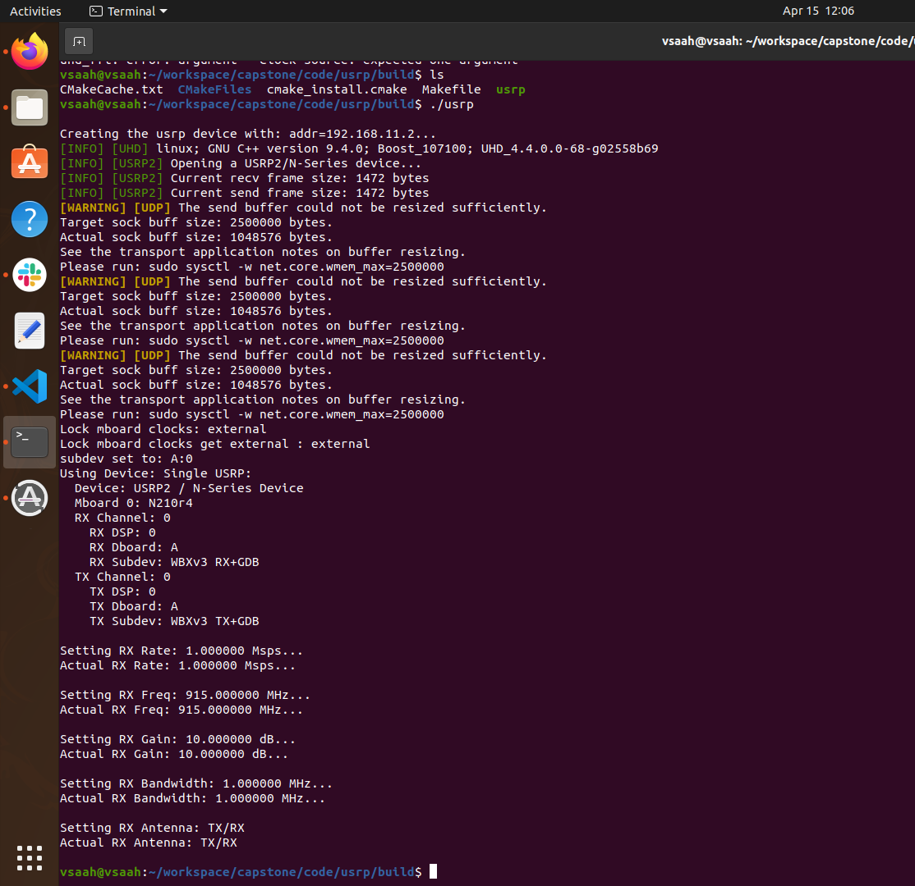
Progress: Lab Testing
USRP interfacing
USRP interfacing using AWG
Receiving samples from USRP

Slide 9
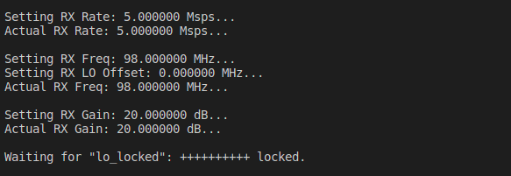
USRP received samples

Slide 10
Progress: Localization Research
Reviewed papers on localization. Found three that presented a similar closed-form solution for 4 or more receivers.
x_{s} =½ (S^{T}S)⁻¹S^{T}(Δ-2R_{s}d)
However, this still requires the distance between the transmitter and the reference receiver (R_{s}), which is unknown.
The papers differ on their solution to this. The one we got to work is the one presented in "Passive Source Localization Employing Intersecting Spherical Surfaces from Time-of-Arrival Differences" by Schau & Robinson
This closed form solution can be input into an iterative algorithm to get an even better estimate

Slide 11
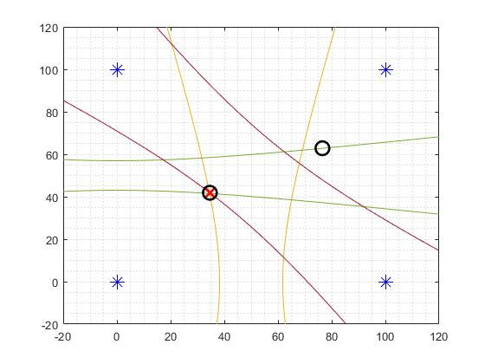
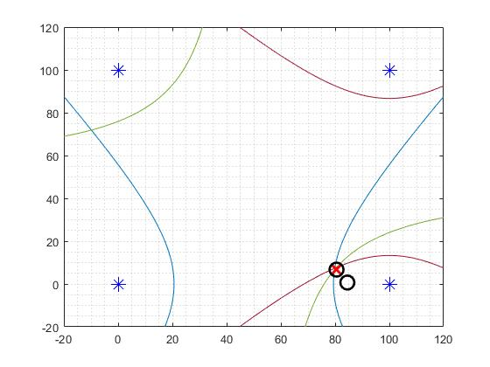
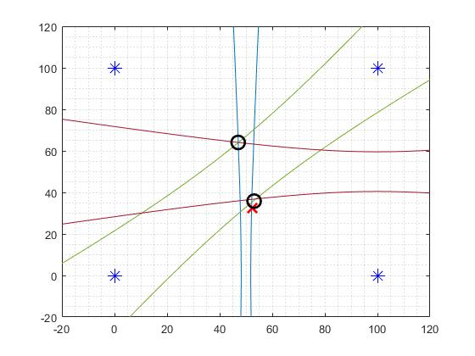
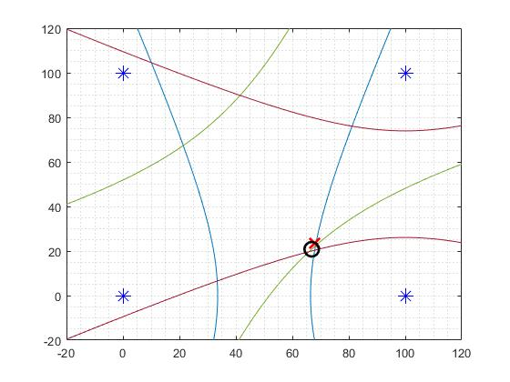
Progress: Localization Simulation
No noise
Noise Added

Slide 12
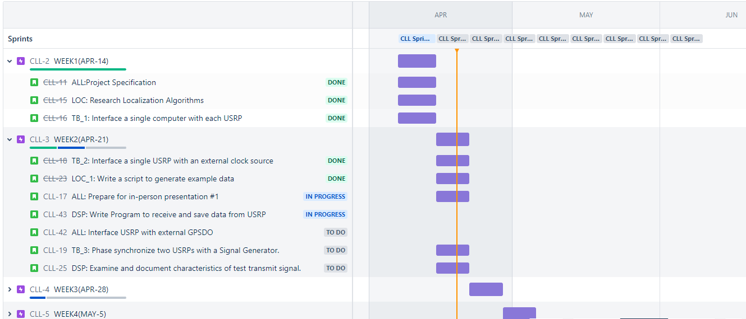
Schedule
https://capstone-wes207.atlassian.net/jira/software/projects/CLL/boards/1/roadmap

Slide 13
Future Plans
Phase Synchronize two USRPs using GPSDOs
Test the sample transmitter in the lab
Collect raw data from transmitter with USRP and save for later analysis
DSP for test signal to determine Time of Arrival
Determine fixes to localization simulation, then port to C++
Create a local network so each part of the system can interact

Slide 14
Basic Block Diagrams(Obsolete)
GPSDO
Storage
2
4
Rx (USRP)
3
DSP
(Host 1)
5
6
Loc Simulation
Host
Controller
2
1
Tx
AWG
UI
1
2
3
5
Rx (USRP)
DSP
(Host 2)
2
4
Storage
GPSDO

